Slide 1


Lecture 10:
CRISP-DM and Python Libraries for Data Science
CoTaPP: Computational Thinking and
Programming with Python
All icons by: https://www.flaticon.com/

Slide 2


Midterm

Slide 3
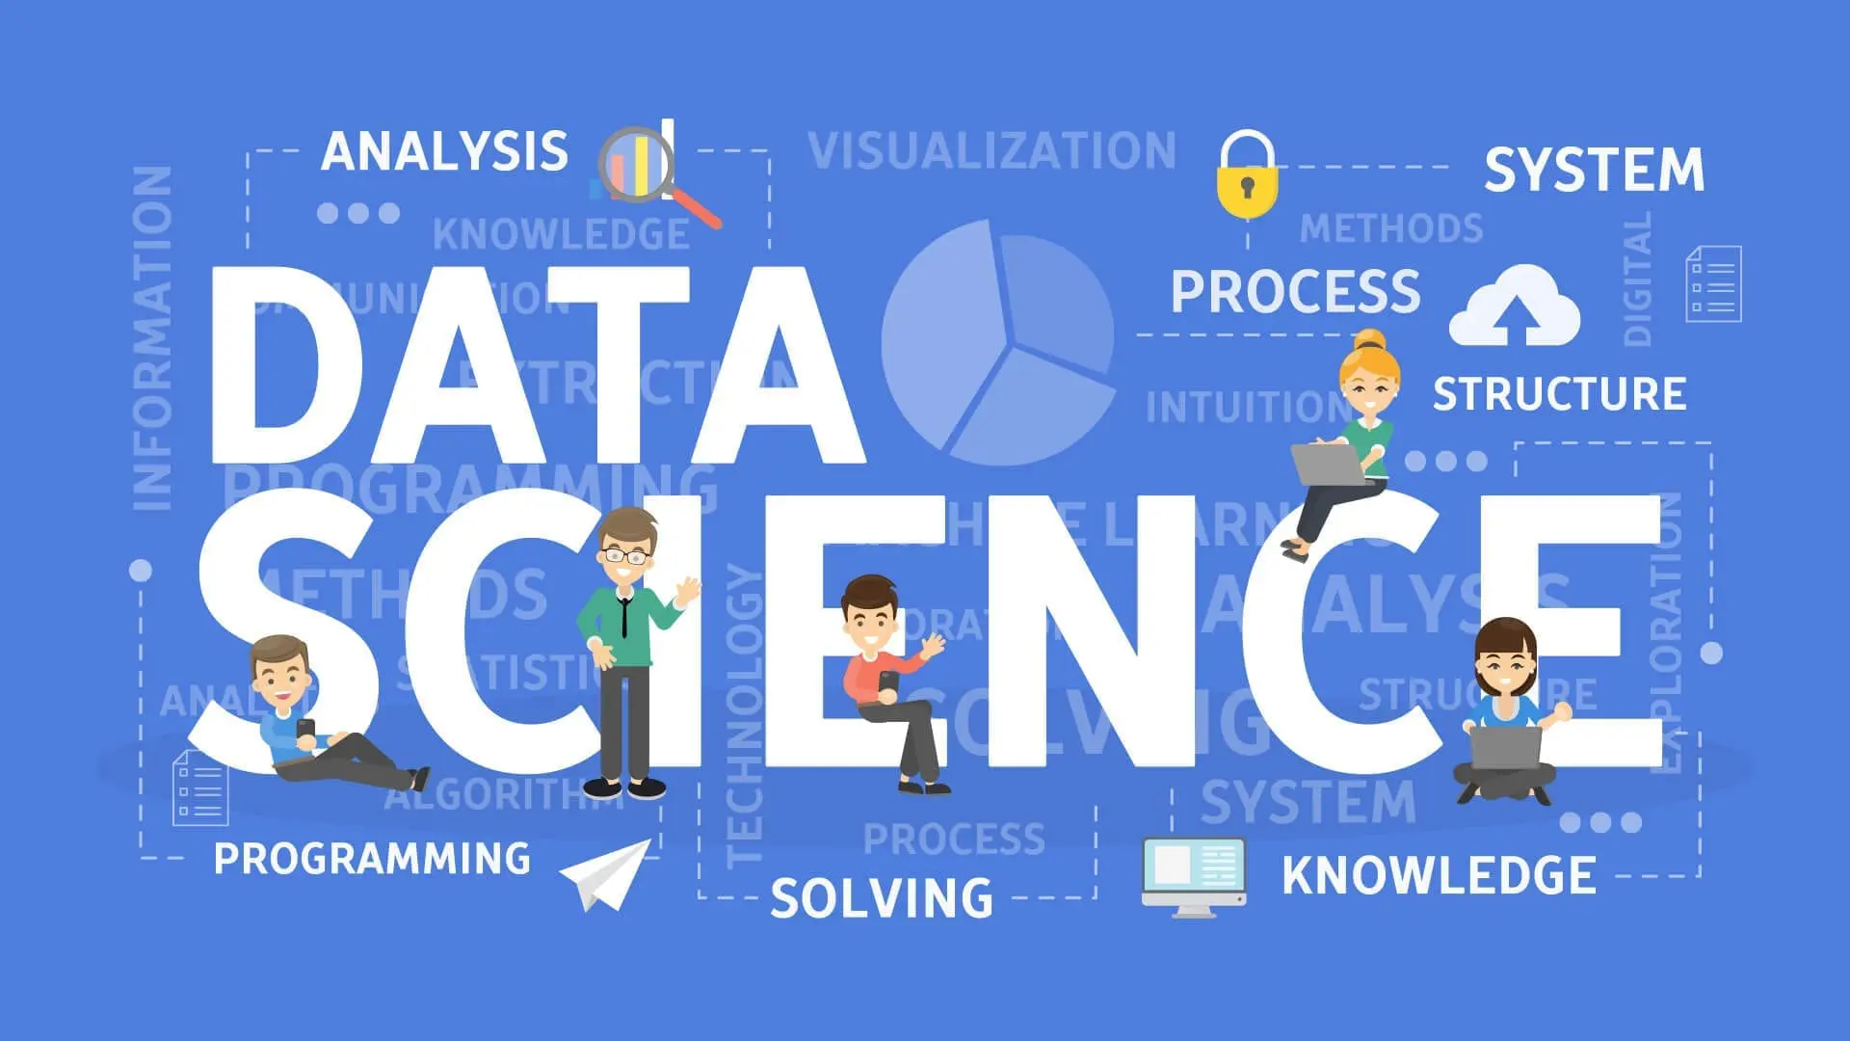
https://www.dataquest.io/blog/what-is-data-science/

Slide 4
What is data science?
Sources: https://towardsdatascience.com/what-is-data-science-8c8fbaef1d37, https://towardsdatascience.com/the-data-scientists-toolbox-part-1-c214adcc859f,https://ourworldindata.org/grapher/daily-covid-deaths-per-million-7-day-average?time=2020-07-07..&country=CAN~DEU~ITA~JPN~KOR~GBR~USA~ESP

Slide 5
What is data science?
Answers can be confusing …
  statistics dressed up in fancy clothes
  statistics on a Mac
  a data scientist has been called a data analyst who lives in California
In broad terms, Data Science is about using data to answer questions
Sources: https://towardsdatascience.com/what-is-data-science-8c8fbaef1d37, https://towardsdatascience.com/the-data-scientists-toolbox-part-1-c214adcc859f,https://ourworldindata.org/grapher/daily-covid-deaths-per-million-7-day-average?time=2020-07-07..&country=CAN~DEU~ITA~JPN~KOR~GBR~USA~ESP

Slide 6
What is data science?
Answers can be confusing …
  statistics dressed up in fancy clothes
  statistics on a Mac
  a data scientist has been called a data analyst who lives in California
In broad terms, Data Science is about using data to answer questions
Sources: https://towardsdatascience.com/what-is-data-science-8c8fbaef1d37, https://towardsdatascience.com/the-data-scientists-toolbox-part-1-c214adcc859f,https://ourworldindata.org/grapher/daily-covid-deaths-per-million-7-day-average?time=2020-07-07..&country=CAN~DEU~ITA~JPN~KOR~GBR~USA~ESP

Slide 7
What is data science?
Answers can be confusing …
  statistics dressed up in fancy clothes
  statistics on a Mac
  a data scientist has been called a data analyst who lives in California
In broad terms, Data Science is about using data to answer questions
Sources: https://towardsdatascience.com/what-is-data-science-8c8fbaef1d37, https://towardsdatascience.com/the-data-scientists-toolbox-part-1-c214adcc859f,https://ourworldindata.org/grapher/daily-covid-deaths-per-million-7-day-average?time=2020-07-07..&country=CAN~DEU~ITA~JPN~KOR~GBR~USA~ESP

Slide 8
What is data science?
Answers can be confusing …
  statistics dressed up in fancy clothes
  statistics on a Mac
  a data scientist has been called a data analyst who lives in California
In broad terms, Data Science is about using data to answer questions
Sources: https://towardsdatascience.com/what-is-data-science-8c8fbaef1d37, https://towardsdatascience.com/the-data-scientists-toolbox-part-1-c214adcc859f,https://ourworldindata.org/grapher/daily-covid-deaths-per-million-7-day-average?time=2020-07-07..&country=CAN~DEU~ITA~JPN~KOR~GBR~USA~ESP

Slide 9
What is data science?
Answers can be confusing …
  statistics dressed up in fancy clothes
  statistics on a Mac
  a data scientist has been called a data analyst who lives in California
In broad terms, Data Science is about using data to answer questions
Sources: https://towardsdatascience.com/what-is-data-science-8c8fbaef1d37, https://towardsdatascience.com/the-data-scientists-toolbox-part-1-c214adcc859f,https://ourworldindata.org/grapher/daily-covid-deaths-per-million-7-day-average?time=2020-07-07..&country=CAN~DEU~ITA~JPN~KOR~GBR~USA~ESP

Slide 10
What is data science?
Specifically, a data science project has one of three goals — either to provide insight, establish causality, or make predictions
These three goals are associated with the domains of data analysis, statistics, and machine learning.
Sources: https://towardsdatascience.com/what-is-data-science-8c8fbaef1d37, https://towardsdatascience.com/the-data-scientists-toolbox-part-1-c214adcc859f,https://ourworldindata.org/grapher/daily-covid-deaths-per-million-7-day-average?time=2020-07-07..&country=CAN~DEU~ITA~JPN~KOR~GBR~USA~ESP

Slide 11
What is data science?
Specifically, a data science project has one of three goals — either to provide insight, establish causality, or make predictions
These three goals are associated with the domains of data analysis, statistics, and machine learning.
Sources: https://towardsdatascience.com/what-is-data-science-8c8fbaef1d37, https://towardsdatascience.com/the-data-scientists-toolbox-part-1-c214adcc859f,https://ourworldindata.org/grapher/daily-covid-deaths-per-million-7-day-average?time=2020-07-07..&country=CAN~DEU~ITA~JPN~KOR~GBR~USA~ESP

Slide 12
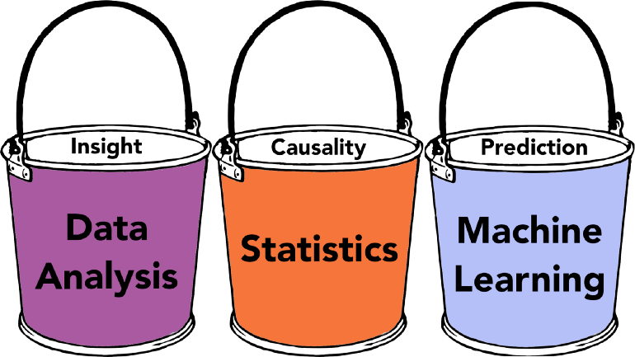
What is data science?
Specifically, a data science project has one of three goals — either to provide insight, establish causality, or make predictions.
These three goals are associated with the domains of data analysis, statistics, and machine learning.
Sources: https://towardsdatascience.com/what-is-data-science-8c8fbaef1d37, https://towardsdatascience.com/the-data-scientists-toolbox-part-1-c214adcc859f,https://ourworldindata.org/grapher/daily-covid-deaths-per-million-7-day-average?time=2020-07-07..&country=CAN~DEU~ITA~JPN~KOR~GBR~USA~ESP

Slide 13
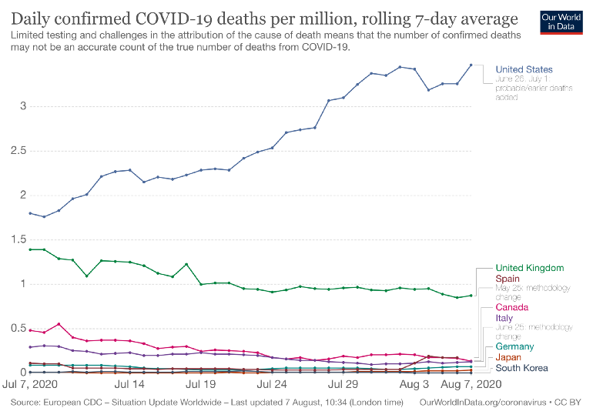
What is data science?
Sources: https://towardsdatascience.com/what-is-data-science-8c8fbaef1d37, https://towardsdatascience.com/the-data-scientists-toolbox-part-1-c214adcc859f,https://ourworldindata.org/grapher/daily-covid-deaths-per-million-7-day-average?time=2020-07-07..&country=CAN~DEU~ITA~JPN~KOR~GBR~USA~ESP

Slide 14
Data science and CoTaPP
CoTaPP is not a data science course
But, you are getting some foundations for data science
  Python
  Collecting/working with data
  Libraries for data science
A Road Map for Data Science: https://towardsdatascience.com/a-road-map-for-data-science-d1977504a72b

Slide 15
Data science and CoTaPP
CoTaPP is not a data science course
But, you are getting some foundations for data science
  Python
  Collecting/working with data
  Libraries for data science
A Road Map for Data Science: https://towardsdatascience.com/a-road-map-for-data-science-d1977504a72b

Slide 16
Data science and CoTaPP
CoTaPP is not a data science course
But, you are getting some foundations for data science
  Python
  Collecting/working with data
  Libraries for data science
A Road Map for Data Science: https://towardsdatascience.com/a-road-map-for-data-science-d1977504a72

Slide 17
Data science and CoTaPP
CoTaPP is not a data science course
But, you are getting some foundations for data science
  Python
  Collecting/working with data
  Libraries for data science
A Road Map for Data Science: https://towardsdatascience.com/a-road-map-for-data-science-d1977504a72b

Slide 18
Data science and CoTaPP
CoTaPP is not a data science course
But, you are getting some foundations for data science
  Python
  Collecting/working with data
  Libraries for data science
A Road Map for Data Science: https://towardsdatascience.com/a-road-map-for-data-science-d1977504a72b

Slide 19
Data science and CoTaPP
CoTaPP is not a data science course
But, you are getting some foundations for data science
  Python
  Collecting/working with data
  Libraries for data science
A Road Map for Data Science: https://towardsdatascience.com/a-road-map-for-data-science-d1977504a72b

Slide 20
Previous lecture
Reading files (local machine)
Remote resources (server - WWW)
the basics of resources on the web,
how to access remote resources (files, REST services),
XML files
how to scrape content form the HTML representation of websites
→ web scrapping

Slide 21
Previous lecture
Reading files (local machine)
Remote resources (server - WWW)
  the basics of resources on the web,
  how to access remote resources (files, REST services),
  XML files
  how to scrape content form the HTML representation of websites
    → web scrapping

Slide 22
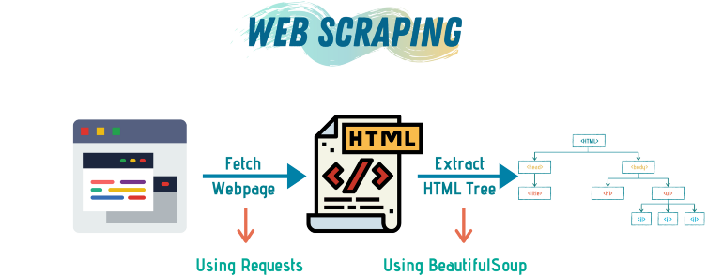
Previous lecture
https://towardsdatascience.com/a-step-by-step-guide-to-web-scraping-in-python-5c4d9cef76e8

Slide 23
Previous lecture
When/why do we need web scrapping?
https://towardsdatascience.com/a-step-by-step-guide-to-web-scraping-in-python-5c4d9cef76e8

Slide 24
Collecting data
Look for data and information to analyze and manipulate

Slide 25
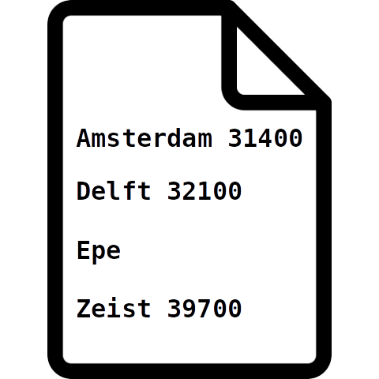
Collecting data
Look for data and information to analyze and manipulate

Slide 26
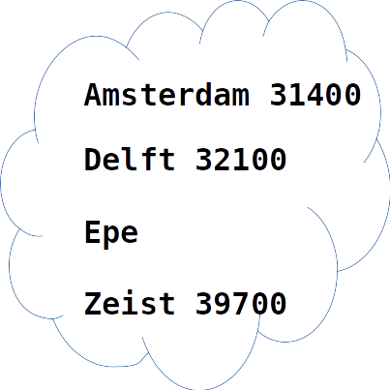
Collecting data
Look for data and information to analyze and manipulate

Slide 27
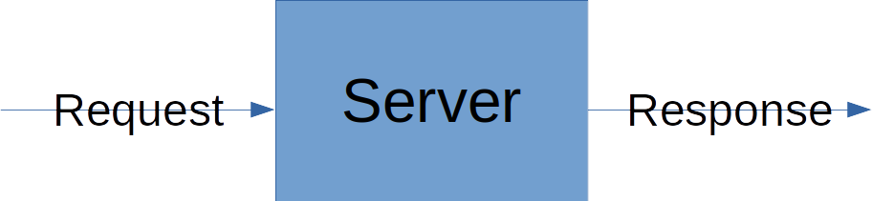
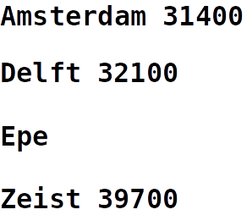
Collecting data
Look for data and information to analyze and manipulate

Slide 28

Collecting data
Look for data and information to analyze and manipulate

Slide 29
Web Scrapping projects
https://www.projectpro.io/article/web-scraping-projects-ideas/475
Flights Ticket Price Analysis

Slide 30
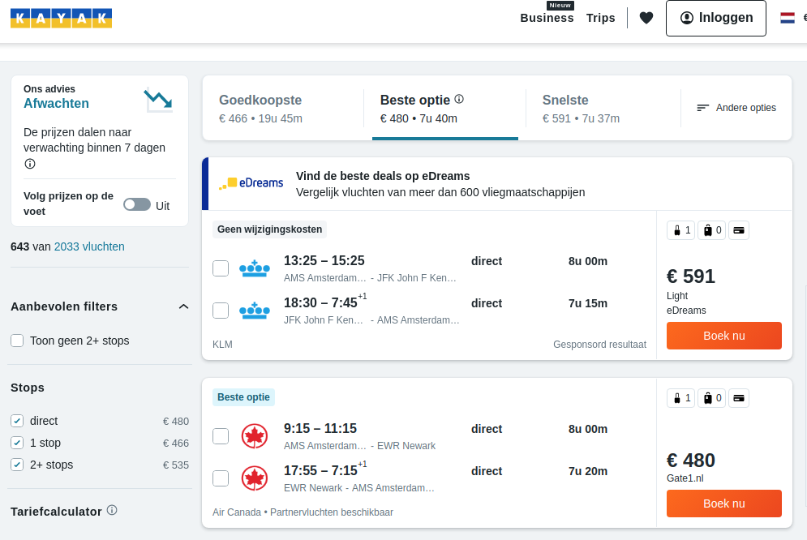
Web Scrapping projects
https://www.projectpro.io/article/web-scraping-projects-ideas/475
Flights Ticket Price Analysis

Slide 31
Today’s lecture
A model for approaching data analysis problems
  CRISP-DM
Python libraries for data science applications
Pandas
Numpy
Matplotlib

Slide 32
Today’s lecture
A model for approaching data analysis problems
  CRISP-DM
Python libraries for data science applications
  Pandas
  Numpy
  Matplotlib

Slide 33
Approaching Data Analysis Problems: CRISP-DM
How to approach complex data analysis problems?
  Cross-Industry Standard Process for Data Mining
CRISP-DM provides a reference model describing how data mining experts typically proceed to address their problems
It gives orientation which steps to perform in a data science project
It divides the process into six major phases

Slide 34
Approaching Data Analysis Problems: CRISP-DM
How to approach complex data analysis problems?
  Cross-Industry Standard Process for Data Mining
CRISP-DM provides a reference model describing how data mining experts typically proceed to address their problems
It gives orientation which steps to perform in a data science project
It divides the process into six major phases

Slide 35
Approaching Data Analysis Problems: CRISP-DM
How to approach complex data analysis problems?
  Cross-Industry Standard Process for Data Mining
CRISP-DM provides a reference model describing how data mining experts typically proceed to address their problems
It gives orientation which steps to perform in a data science project
It divides the process into six major phases

Slide 36
Approaching Data Analysis Problems: CRISP-DM
How to approach complex data analysis problems?
  Cross-Industry Standard Process for Data Mining
CRISP-DM provides a reference model describing how data mining experts typically proceed to address their problems
It gives orientation which steps to perform in a data science project
It divides the process into six major phases

Slide 37
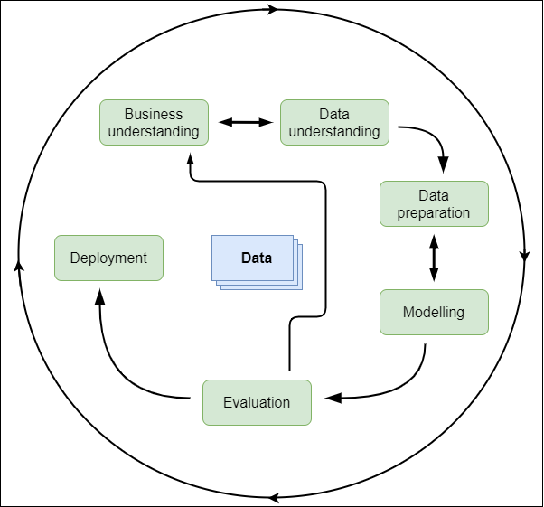
life cycle of a project
https://commons.wikimedia.org/w/index.php?curid=24930610

Slide 38
1. Business Understanding
Initial phase
Understand / define the general project objectives from a “business” or research perspective
Which (research) questions should the data analysis project answer?
Setup of a project plan

Slide 39
2. Data Understanding
Become familiar with the available data
Collect, describe, and explore initial data for the project objectives
Discover first insights into the data
Verify the quality of the data.

Slide 40
3. Data Preparation
Turn the initial data set into the final data set that will be used for the analysis
Depending on the situation, this might include
  selecting,
  cleaning,
  constructing,
  integrating (merge) and
  formatting data to make them ready for further processing

Slide 41
4. Modeling
Select the analysis techniques to be used on the data set
Describe the overall computational process (e.g. with UML Activity Diagrams)
Do the implementation (e.g. with Python)
Execute on the prepared data set

Slide 42
5. Evaluation
Critically review
  the computational model
  program and
  results
Are they correct?
Do they achieve the project objectives?
If not, the previous phases should be applied again to identify and eliminate the problems.

Slide 43
6. Deployment
Deploy the final data, process, program, results and project report
Plan making for monitoring and maintenance of data and software artifacts
Review of the complete project

Slide 44
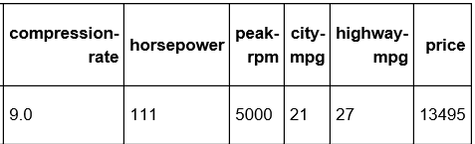
Quick Example: Predict Car Prices
https://medium.com/@christophberns/using-crisp-dm-to-predict-car-prices-f15eb5b14025
1. Business Understanding | A car dealer needs to estimate what the price of a used car could be. Can the price of a car be predicted based in its attribute with reasonable accuracy?
2. Data Understanding
3. Data Preparation | Replace a missing value in a column by the average of all other values in that column
4. Modeling | To come up with a model for predicting the price based on the other features, use the k-nearest neighbors (kNN) algorithm
5. Evaluation | To evaluate the performance of the kNN model, use a metric to valuate how accurate are the predictions of the model
6. Deployment | If the model is good, give it to the car dealer

Slide 45
Python Libraries for Data Science
Pandas
  Data manipulation and analysis
  Data frame
Numpy
  Support for large, multi-dimensional arrays and matrices
Matplotlib
  Plots

Slide 46


Slide 47
To Do
Exercises for the week
  Use quarterfall to submit them
Work in Project 2
Study for the midterm
Practice practice practice!
Ask questions!

Slide 48
Next lecture
Regular Expressions
  useful to find patterns in text
  not only useful in Python programs

